Slide 1

CS 147 - Designing for Healthy Behaviors
High-fi Prototype Checkpoint

Slide 2
Value Proposition
Build essential skills, one experience at a time

Slide 3
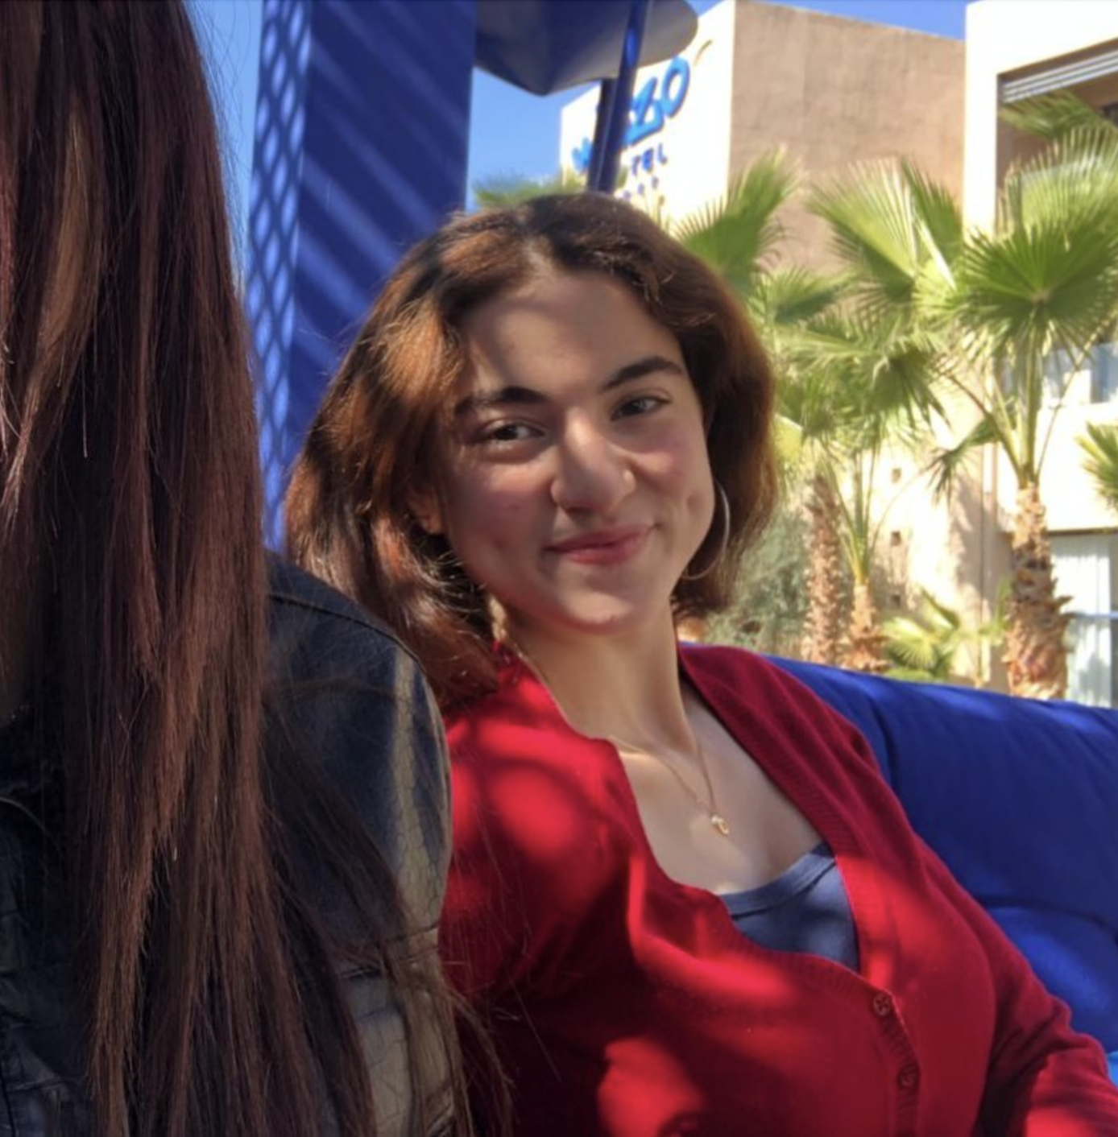
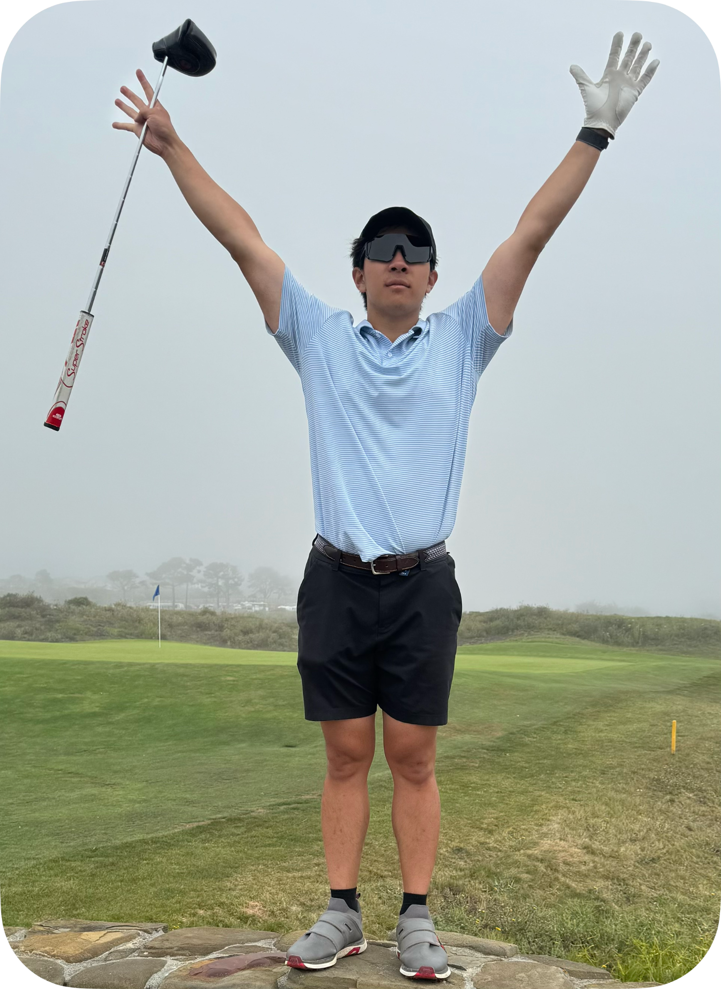


Team Intro
Taralyn
Maroua
Nick
Varsha
Class of 2026
Computer Science
Class of 2024 (2025?)
Mechanical Engineering
Class of 2026
Computer Science
Class of 2026
Computer Science

Slide 4
Problem
Students and Early Career Professionals often face challenges in developing essential interpersonal skills critical for career growth. These skills, which are rarely taught in traditional classroom settings, cause stress and uncertainty in navigating one’s career path

Slide 5
Solution
breaks down the challenge of building soft skills into bite-sized experiences across four key areas. With personalized daily challenges, the chance to explore and compete with friends, and tools to track your growth, users are able to develop career enhancing skills, one experience at a time.

Slide 6
Table of Contents
Heuristic Evaluation Results 01
Revisions for High-fi 02
High-fi Implementation 03
Demo of Task Flow 04

Slide 7
01
Heuristic Evaluation Results
Notes:
[1 minute in]

Slide 8
Qualitative Summary
1) Concept
Unintuitive App Flow
Limited context and documentation for onboarding
Inconsistent terminology –use of “task” and “experience”
2) Aesthetics & Layout
Inconsistent Buttons
Difficulties differentiating buttons and experience cards
Colors did not match with each other
Text hard to read
3) Experience Cards
Full card component was excessively large
Too many clickable buttons–overwhelms user
Not consistent with visual hierarchy
4) Complex Task Flow
Unable to view your received and sent challenges
Unable to send multiple challenges to friend/ send multiple friends a challenge
5) Profile Page
Lack of information –does not have profile name
Limited freedom, unable to change profile picture or name
6) Navigation
Screen navigation was too quick to read
Pop-ups were not smooth
Some screens lacked back, next, and/or exit buttons.

Slide 9
Statistics: Total Violations
went through all 101 violations
as a group

Slide 10
Statistics: Violations by Severity
32
69
severity 3/4 violations
severity 1/2 violations
29 addressed
55 addressed

Slide 11
Statistics: Most Violated Heuristics
H8: Aesthetic & Minimalist Design (22)
H4: Consistency & Standards (20)
H1: Visibility of System Status (13)

Slide 12
Statistics: All Violations
Heuristic | # Viol. (sev 0) | # Viol. (sev 1) | # Viol. (sev 2) | # Viol. (sev 3) | # Viol. (sev 4) | # Viol. (total)
H1: Visibility of System Status | 3 | 4 | 2 | 2 | 2 | 13
H2: Match b/w System & World | 0 | 5 | 2 | 0 | 0 | 7
H3: User Control & Freedom | 0 | 0 | 1 | 6 | 1 | 8
H4: Consistency & Standards | 0 | 6 | 9 | 4 | 1 | 20
H5: Error Prevention | 0 | 0 | 2 | 0 | 0 | 2
H6: Recognition not Recall | 0 | 0 | 4 | 2 | 1 | 7
H7: Flexibility & Efficiency of Use | 0 | 1 | 2 | 3 | 1 | 7
H8: Aesthetic & Minimalist Design | 0 | 12 | 8 | 0 | 2 | 22
H9: Help Users with Errors | 0 | 0 | 1 | 0 | 0 | 1
H10: Help & Documentation | 0 | 0 | 1 | 0 | 0 | 1
H11: Accessible Design | 0 | 2 | 1 | 3 | 2 | 8
H12. ​​Value Alignment & Inclusion | 0 | 0 | 3 | 1 | 1 | 5
Total Violations | 3 | 30 | 36 | 21 | 11 | 101

Slide 13
02
Revisions for High-fi
Notes:
[1.5 in]

Slide 14
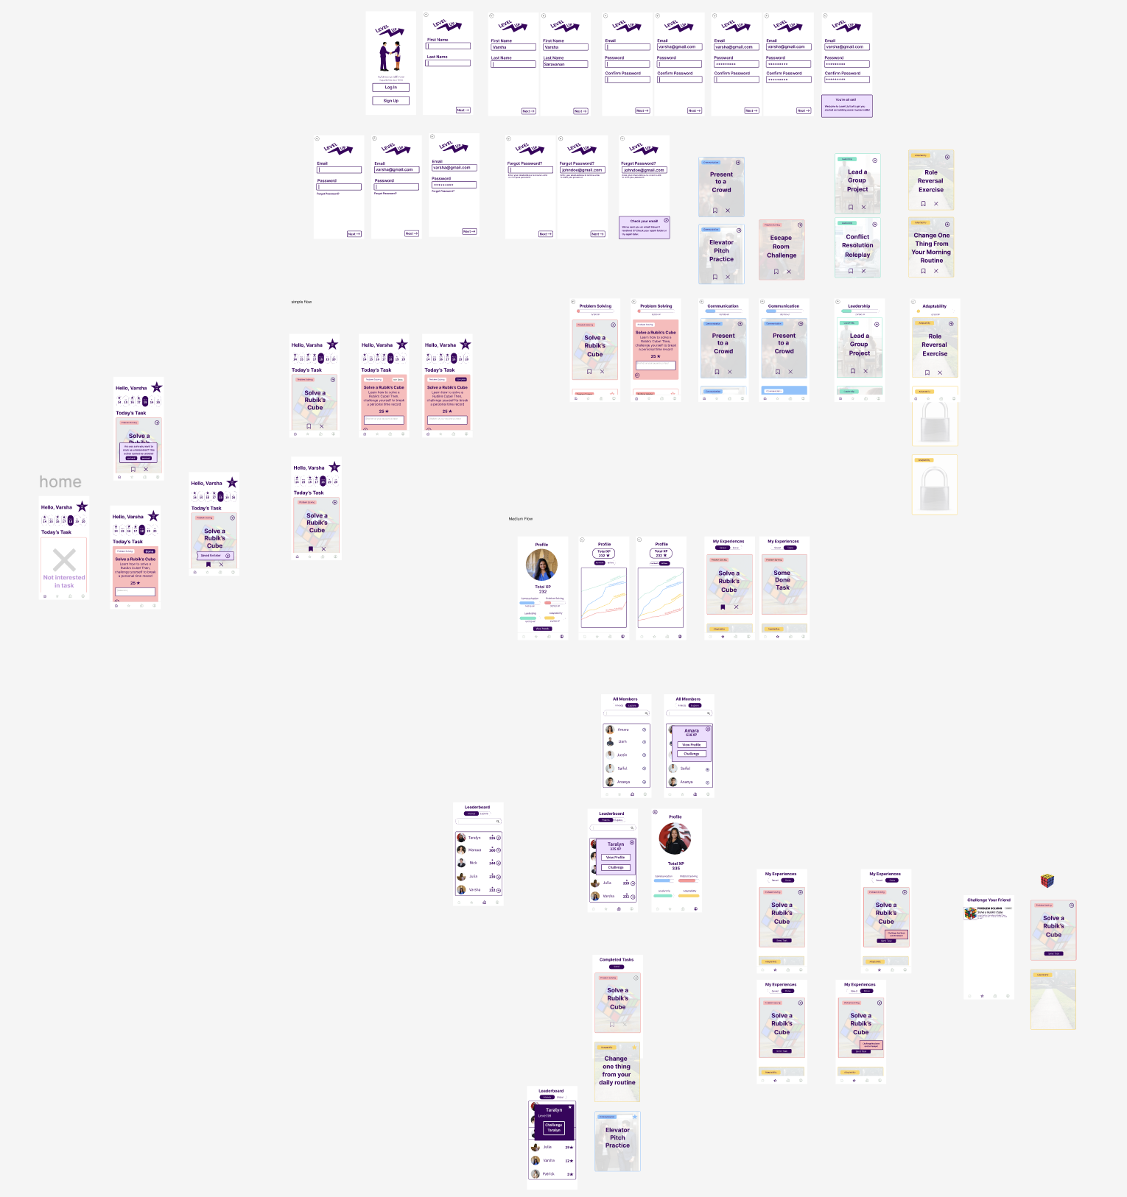
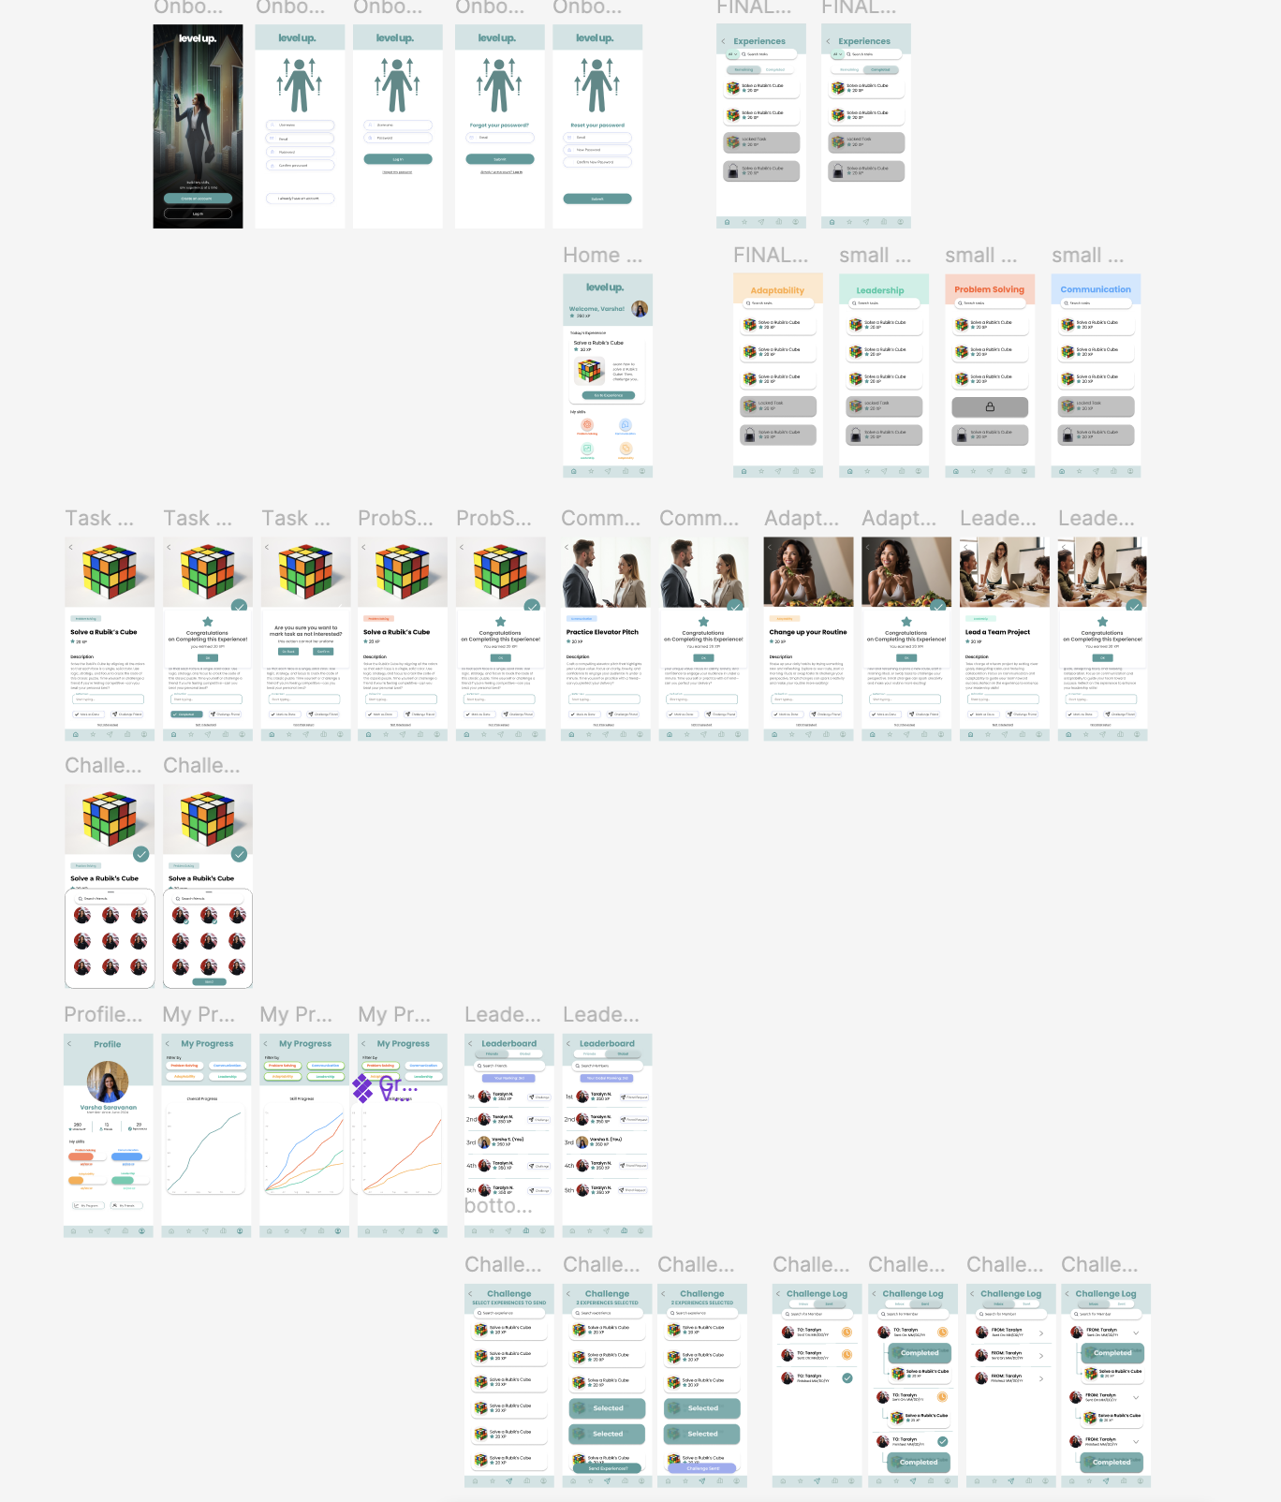
Summary of Changes
Entirely revamped our design: flow, aesthetics, navigation, and functionality
Notes:
This revamp took care of many of the aesthetic and minimalist design violations since so many of our violations were from that

Slide 15
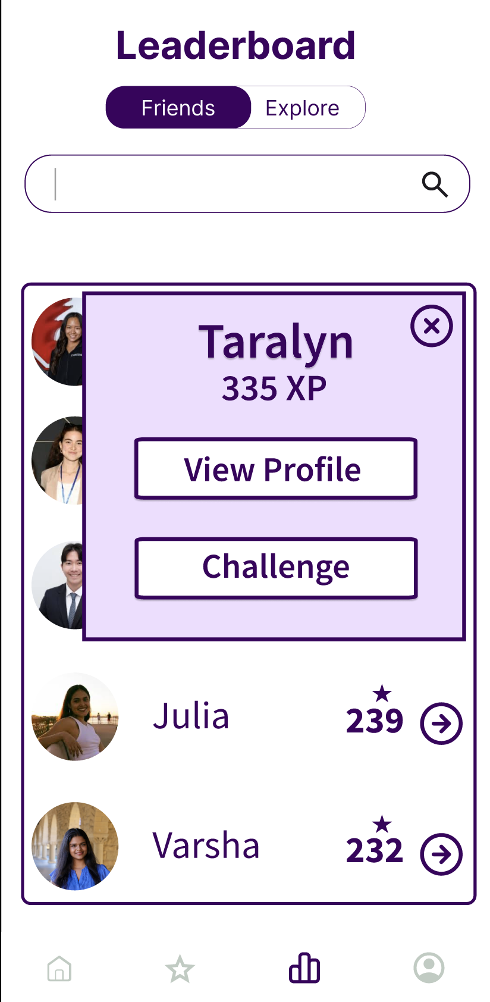
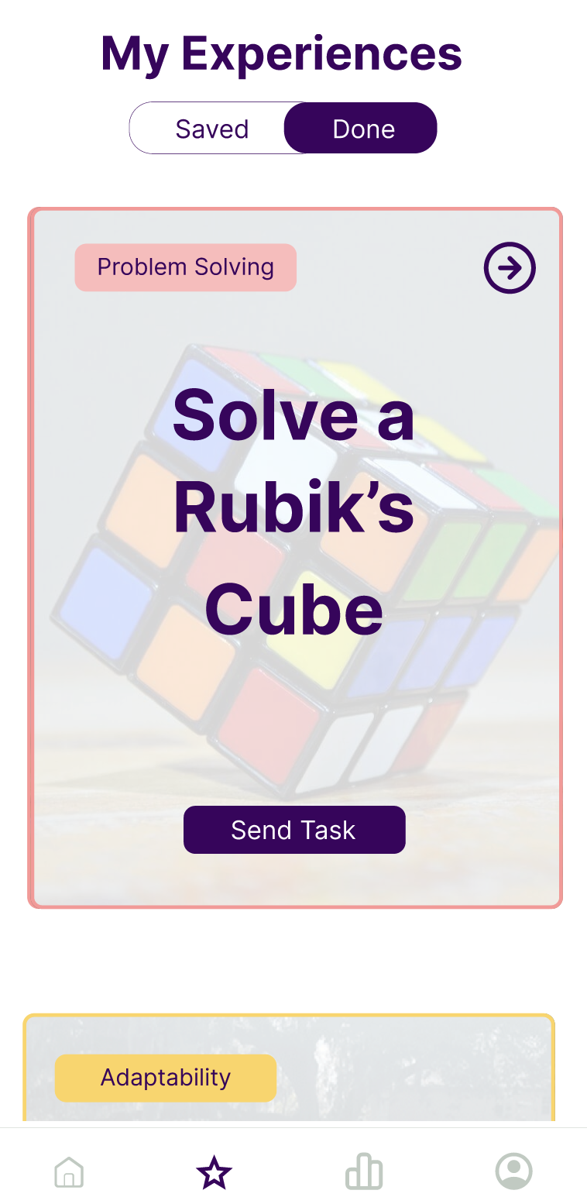
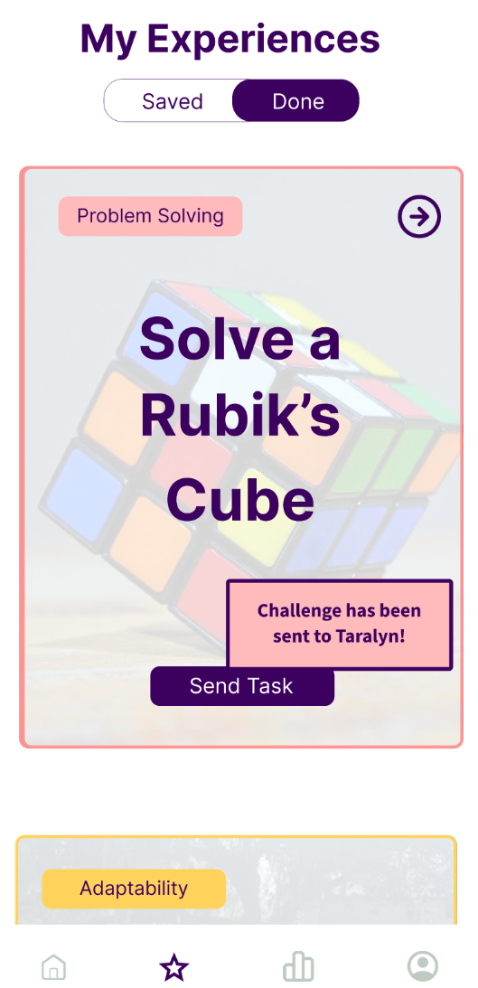
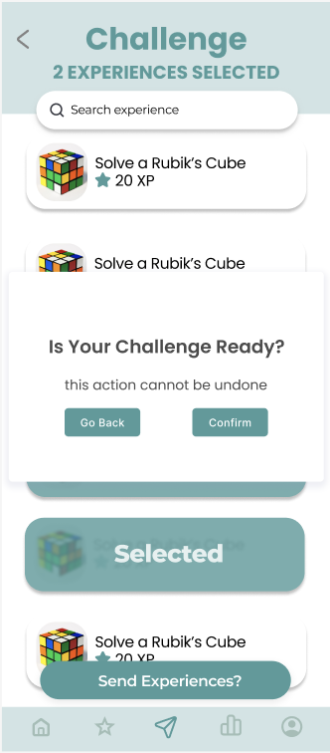
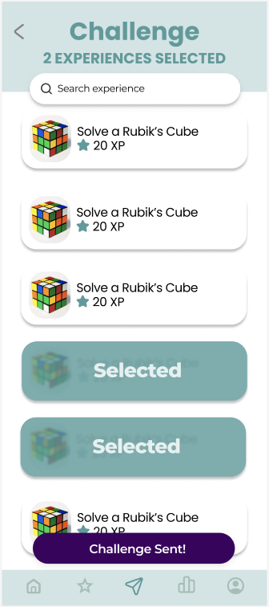
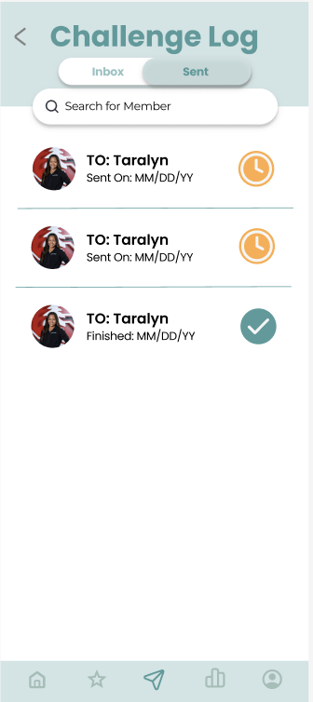
H1: Visibility of System Status
Severity: 4
Violation #8: Timeout for challenging a friend is too fast
Before:
Timeout after sending a friend a challenge is 2s
After:
Confirmation popup does not automatically force timeout until user confirms. Timeout increased to 5s and send them to their Challenge Log where they can see their sent challenges
Notes:
Preface this by saying we had lot of high severity violations across all heuristics and across many features
So i just want to note that we did address nearly all of them (29/32)
So instead of highlighting specific changes in features, bc there was so many, im only going to
discuss the specific violations where addressing them was critical to the revamping of our design

Slide 16
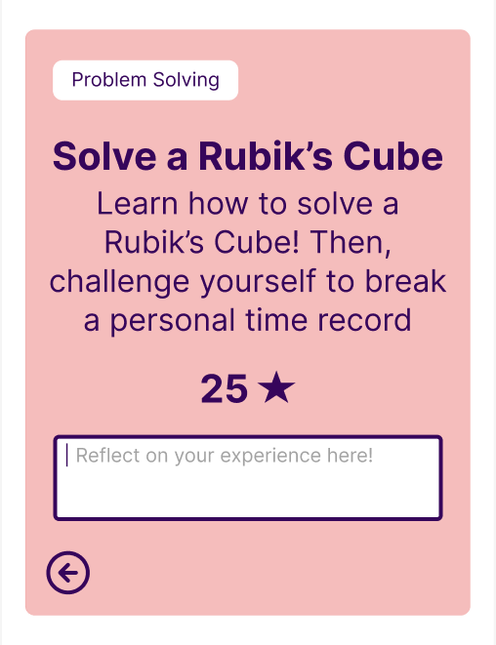
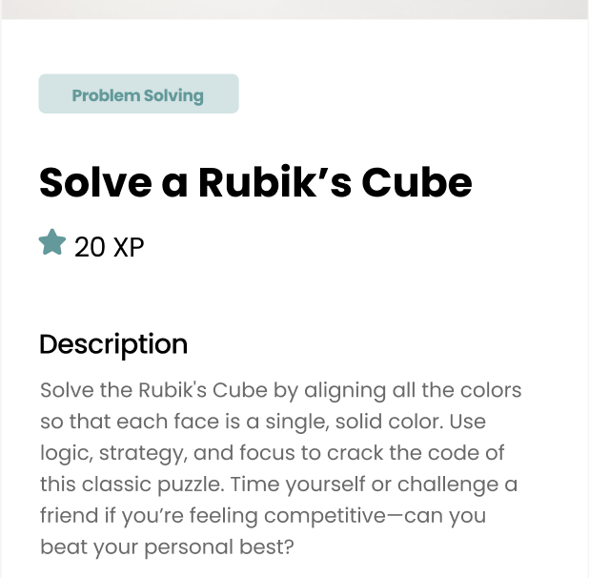
H1: Visibility of System Status
Severity: 3
Violation #17: Star symbol for indicating XP is confusing and does not have values
Before:
Just Star & Value to imply XP
After:
Add “XP” to indicate that stars represent XP and the experience provides 20 XP

Slide 17
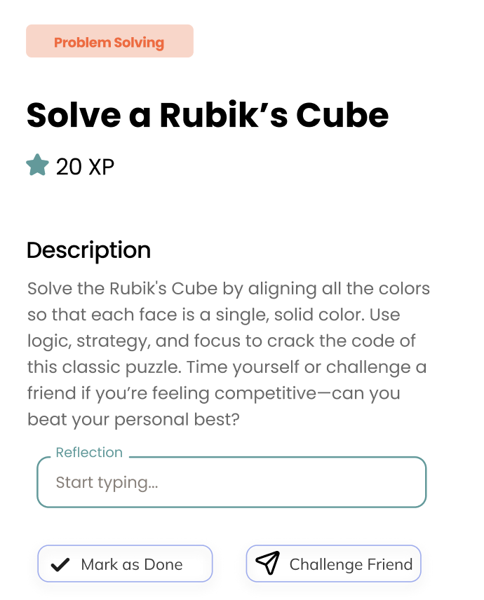
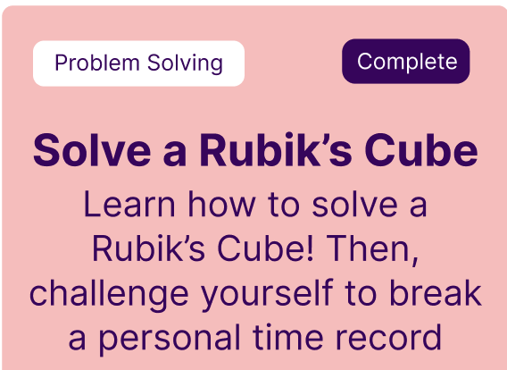
H4: Consistency & Standards
Severity: 3
Violation #79: There are tags that look like buttons: The “Problem Solving” on the task box has a box around it, making it look like a button
Before:
Problem Solving Tag looks the exact same as the Mark as Done/Complete Button
After:
Problem Solving Tag is different color and size compared to Mark as Done/Challenge Friend Buttons

Slide 18
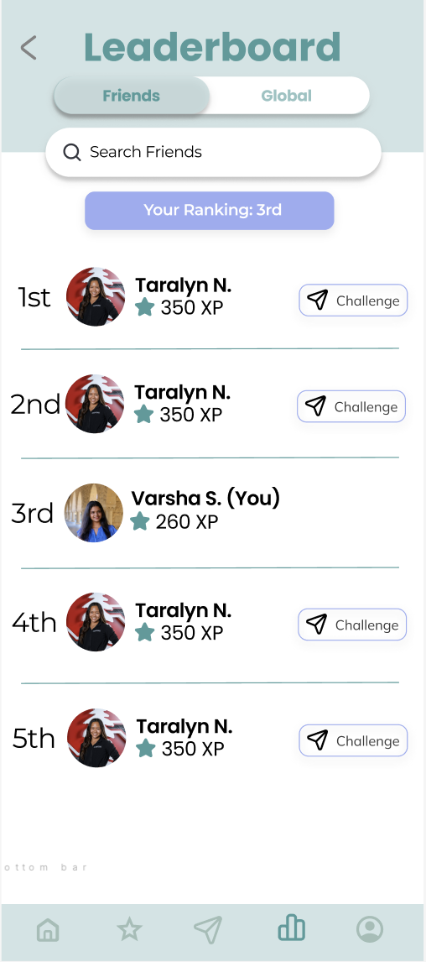
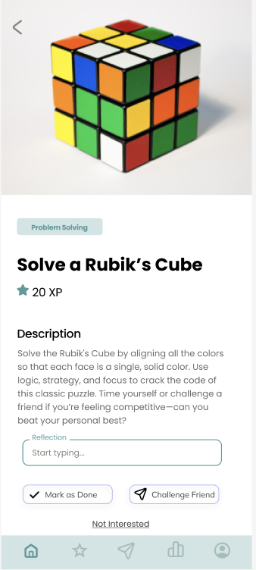
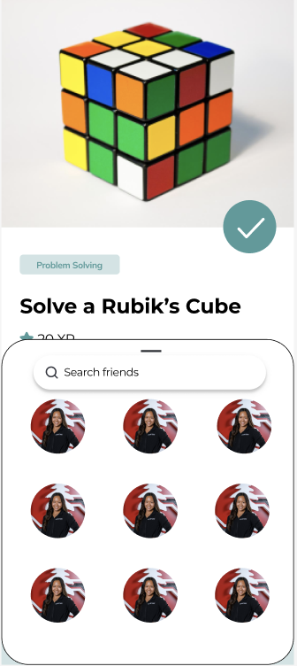
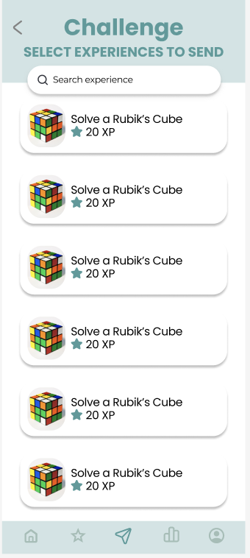
H7: Flexibility & Efficiency of Use
Severity: 3
Violation #24: Challenge a friend task flow is very unclear and is unintuitive
Before:
Challenge Task Flow can only be accessed through Leaderboard and directs to a secondary My Experiences Screen
After:
Challenges can be accessed in 3 ways: There are two ways to send challenges – through an experience card screen or through the leaderboard – and the middle icon on the dashboard accesses the Challenge Log where sent and received challenges are displayed

Slide 19
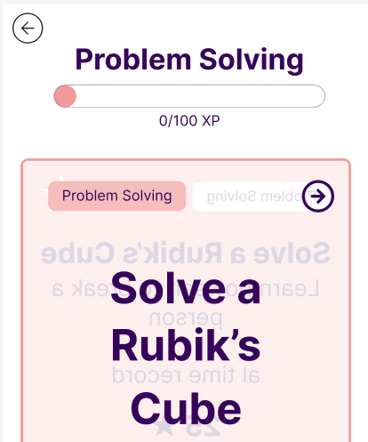
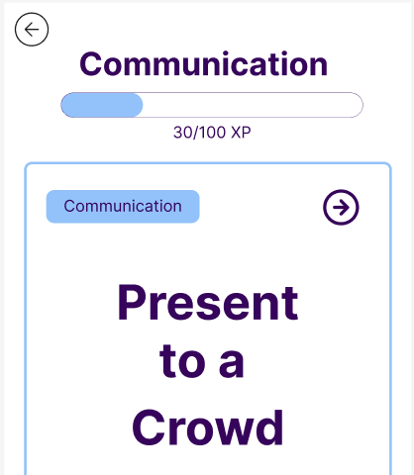
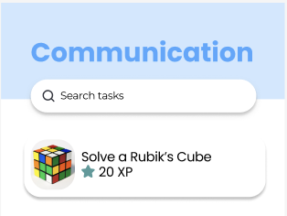
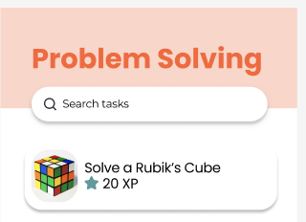
H7: Flexibility & Efficiency of Use
Severity: 3
Violation #44: No Search bar inside each of the skill areas
Before:
Skill areas screens did not have search bar for experiences
After:
Search bar have been added to all skill or experience list screens

Slide 20
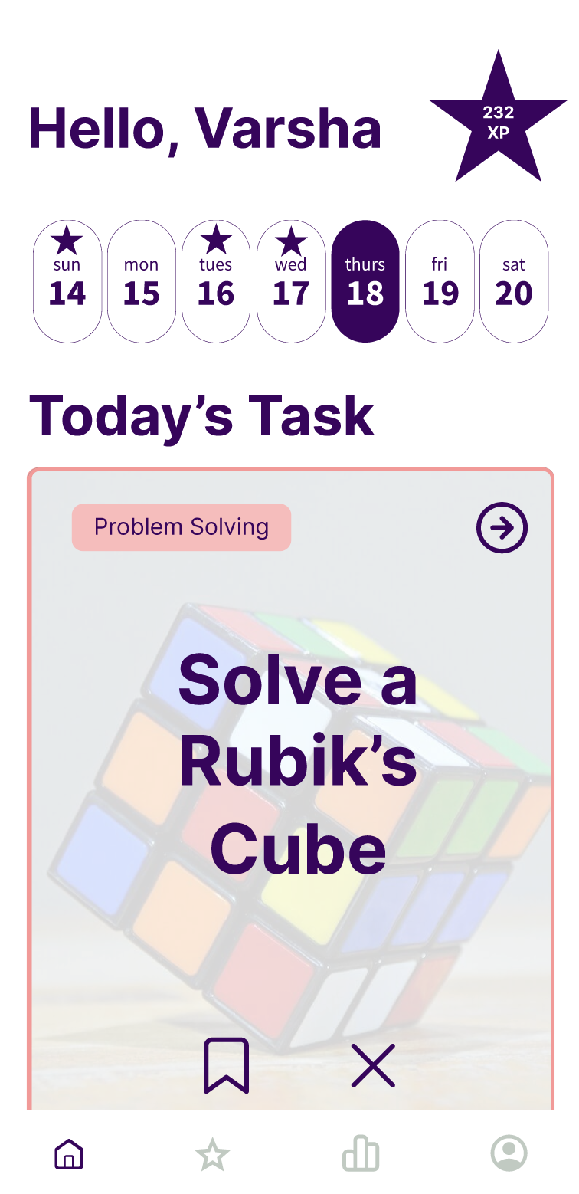
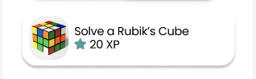
H8: Aesthetics & Minimalist Design
Severity: 4
Violation #82: There are 5 things that look clickable on the task card
Before:
Task Card has multiple clickable buttons, makes it confusing for the user
After:
Experience (Task) Card is a smaller interactable element that aims itself as a whole to be a button to click

Slide 21
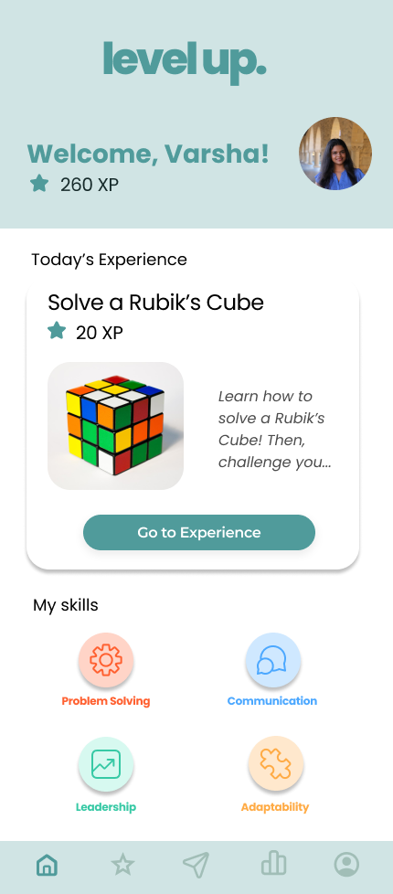
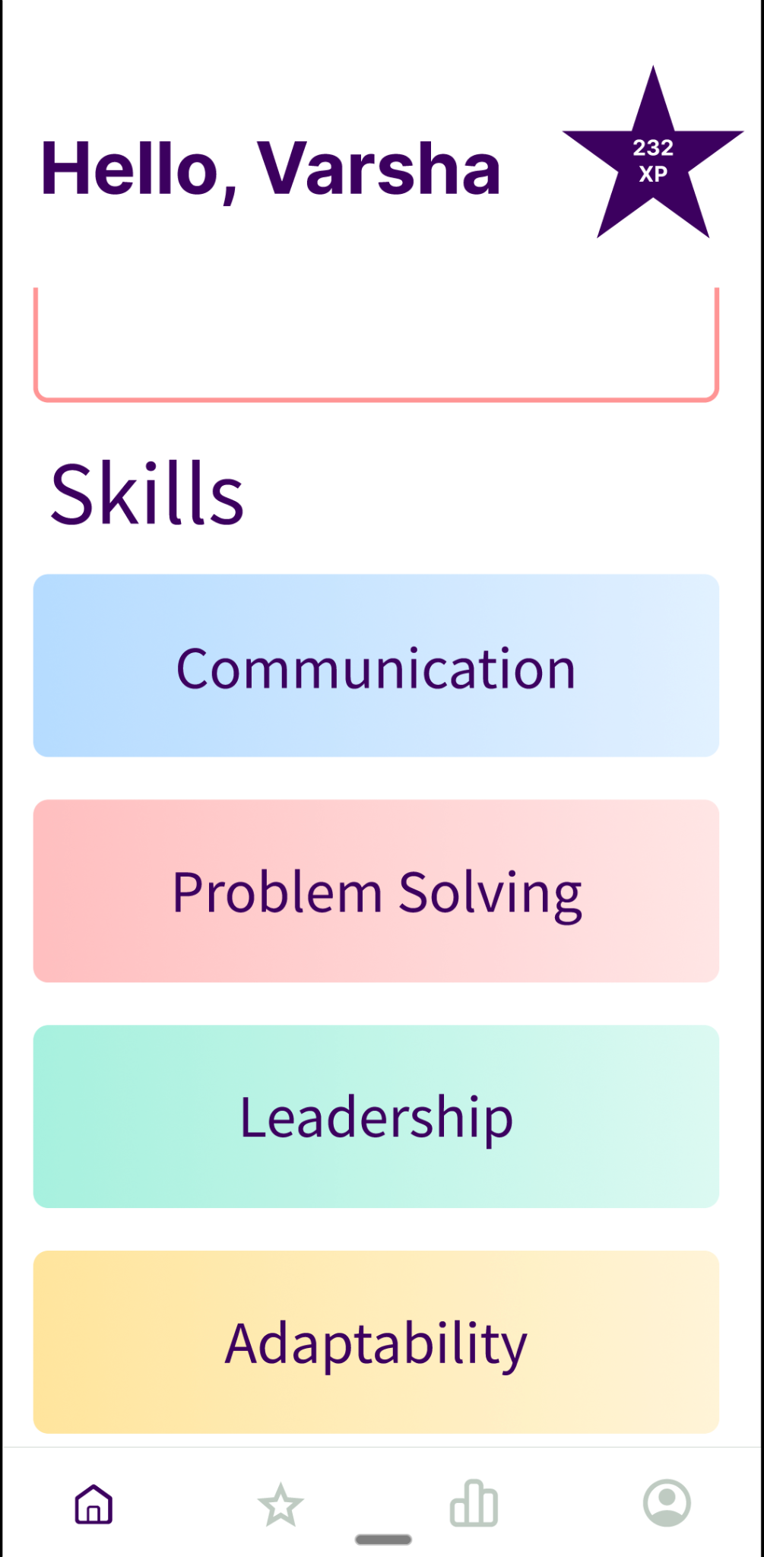
H11: Accessible Design
Severity: 3
Violation #84: Scroll to access the buttons for today’s task, it does not fit the screen on the home page
Before:
Today’s Task Card is cut off in the home screen, skills buttons are hidden below it and scrolling is required to see them
After:
Today’s Experience is made smaller to fit all elements and buttons on the screen. No need to scroll down to see skill buttons now

Slide 22
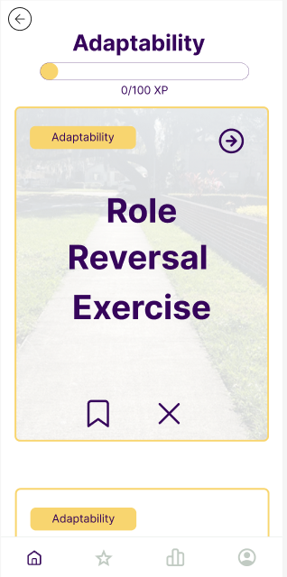
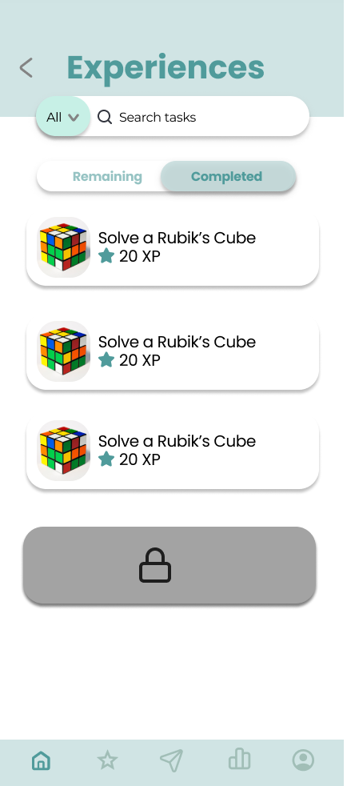
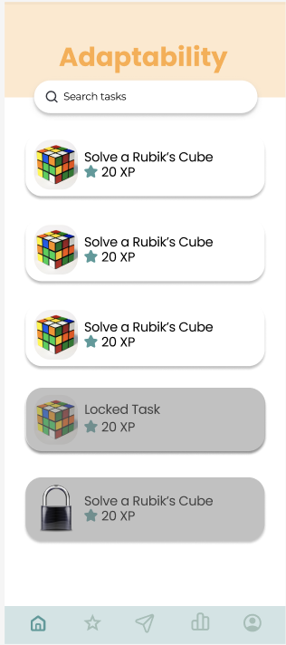
H11: Accessible Design
Severity: 4
Violation #83: Task Cards are too big and cover the screen, Text on Task cards takes up ¼ of the screen
Before:
Task Card is too big and covers the whole screen, can one see one task card at a time
After:
Experience (Task) Card is a smaller on both home screen, experiences screen, and specific skills screens

Slide 23
Violations we did not revise
Heuristic | Severity | Description | Justification
H12: Value Alignment & Inclusion | 3 | The user is not able to choose what skills they would like to improve. | We believe in the future, there is opportunity to add more “skill” categories. These categories encompass the core skills and all contain a wide range of experiences for the user to accomplish.
H6: Recognition, Not Recall | 3 | The task cards only have a vague title, and you need to flip it over to see the rest of the information. | By sizing down the experience card and transferring the description to a separate screen, we believe that short title that gives the general idea of the experience is what the user would like to see.
H3: User Control & Freedom | 3 | Button functionality on task card and leaderboard seems unnecessary – clicking anywhere on card/section leads to flip or navigation | We believe that accessing the details of an experience is central to our value proposition, users should be able to intuitively access it

Slide 24
Progress Towards Usability Goals
Efficiency
Enjoyment
We received good feedback from both our Low-fi testing and Heuristic Evaluation, leading to refinements that improve efficiency.
Differentiated between clickable buttons and tags to ensure reduced friction in app flow
Made terminology more clear, proving sufficient context along the way
Challenge task flow made complete and intuitive, allowing users to send challenges to friends in two ways.
Since most violations fell under “Aesthetics and Minimalist Design”, the revamp addressed many of these violations are once, leading to a more enjoyable user experience
Took inspiration from other designs to make the overall look more aesthetically pleasing
Used components that were more visually appealing and consistent
Took a less is more approach when it came to color usage and button size
Notes:
Paige’s slide + reminder of our usability goals

Slide 25
03
High-fi Implementation
Notes:
[3.5-4]

Slide 26






Tools Used
Figma
Expo Go
VS Code
Supabase
React Native
GitHub
Design
Components
Sandbox
Environment
IDE
Backend
Data Storage
Application
Framework
Collaboration

Slide 27
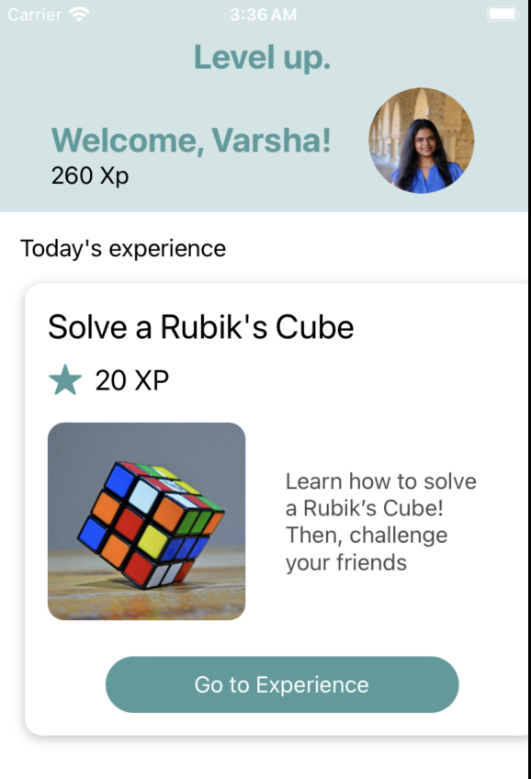
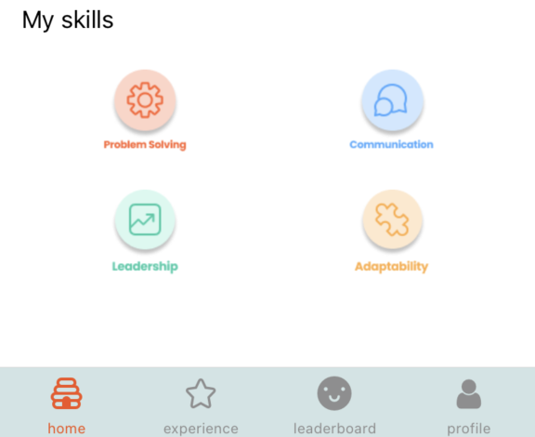
Implemented Features
We implemented the simple task flow (accessing a new task).
Home screen implemented
Experience list for each skill
Experience screen implemented
Toggle between completed and remaining experiences
Profile screen front end
Profile statistics front end
Experience cards navigate to details screen
Notes:
45 s

Slide 28
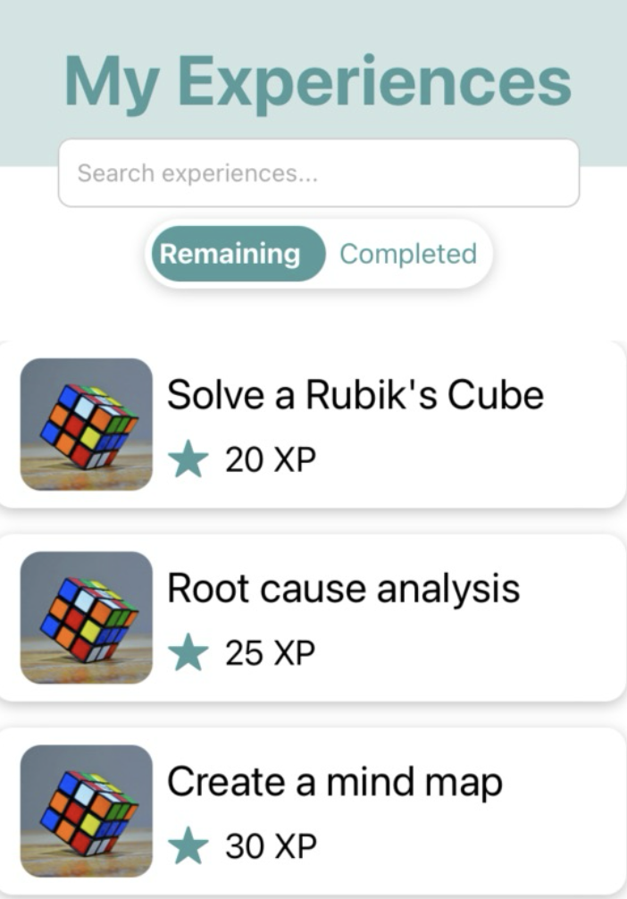
Wizard of Oz Techniques
Hard Coded Aspects
Currently a closed system
Today’s Experience recommendation
One logged in user
The list of remaining and completed experiences
Skill / XP progress on profile and home header
Photos on experience card (all Rubik’s Cube)
Task detail screen
Notes:
45 s

Slide 29
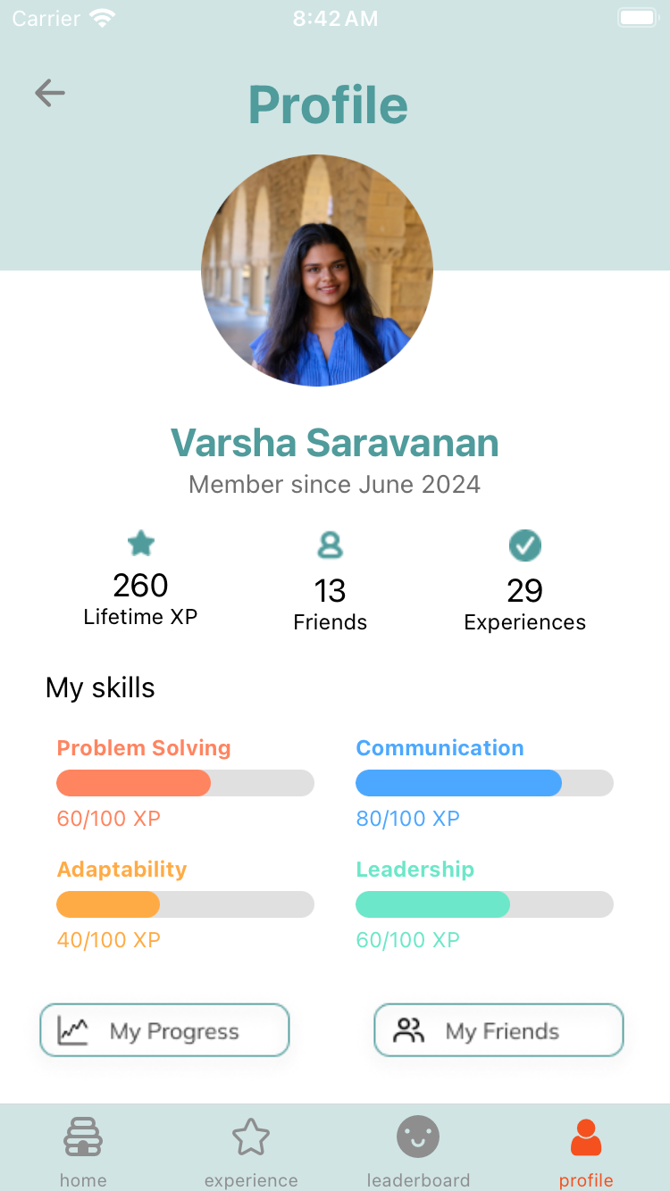
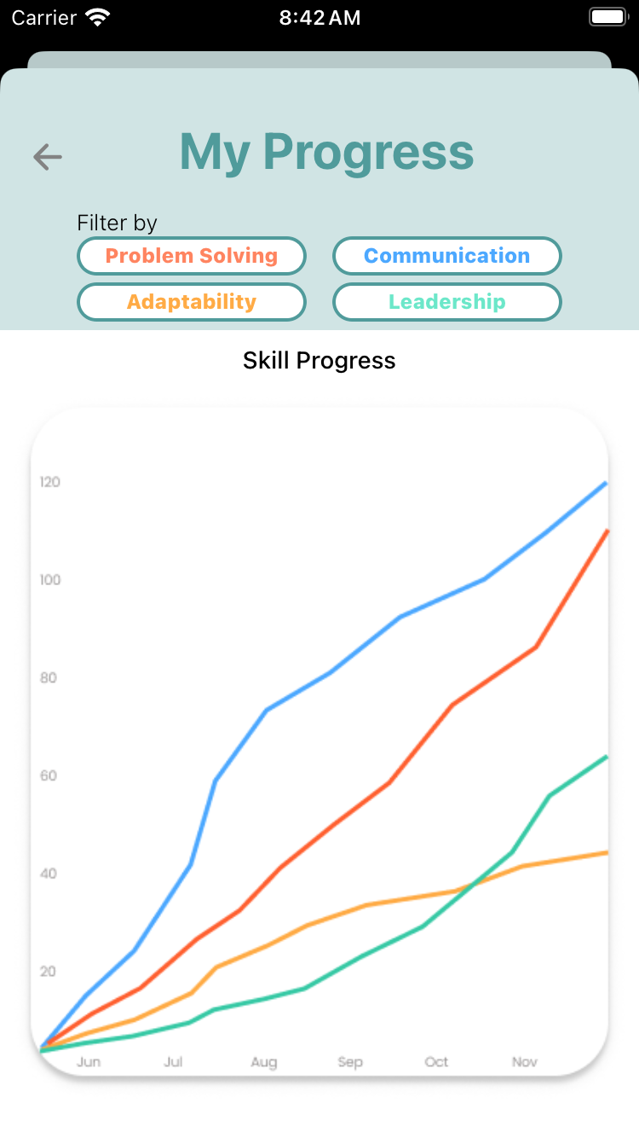
Partially Implemented Medium Task Flow
Added personal stats on profile
Ability to filter by skill and view progress graphically
Notes:
45s

Slide 30
Unimplemented Features & Concepts
We will continue to build our Medium task flow (track progress over time) and will implement our Complex task flow.
Users will be able to track progress through XP’s, skill-wise progress bars, and the skills graph.
Users will be able to compete by sending one challenge to multiple friends or sending multiple challenge to one friend (two ways).
Notes:
45s

Slide 31
Questions/Issues
Unsure how to add images to our task cards via Supabase. Currently, we have the Rubik’s cube image for all cards to prevent hard coding images into respective cards.
Unsure how to pass in variables to screens to map each task details page
We have not determined how to create interactions for the “Not Interested” feature
Notes:
30s

Slide 32
Our Plan
Code simple task
Code
medium
task
Code
complex
task
Finishing UI touches
Redo
Figma
Poster & Pitch
Notes:
10s

Slide 33
04
Demo of Task Flow

Slide 34
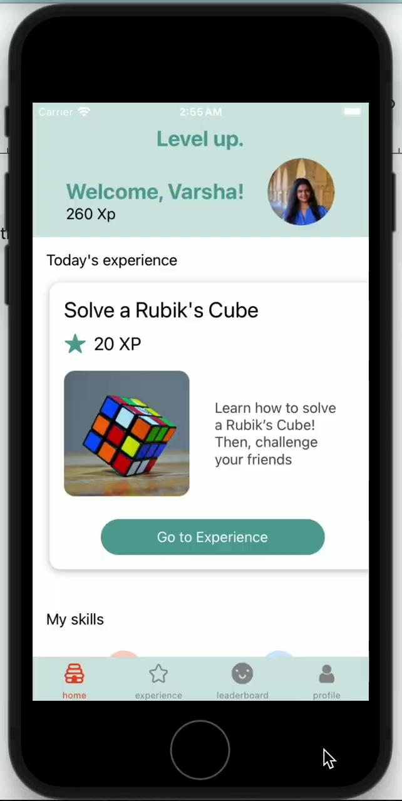

Slide 35
05
Appendix

Slide 36
Updated Med-fi design: Link

Slide 37
Other High Severity Violations
H1: Visibility of System Status [3-4]
Timeout for challenging a friend is too fast
Star symbol for indicating XP is confusing and does not have values
Profile page has inconsistent exp values
Trend charts not labeled
H3: User Control & Freedom [3-4]
Button functionality on task card and leaderboard seems unnecessary–clicking anywhere on card/section leads to flip or navigation
No confirmation before sending challenge to a friend or sending a friend request to a stranger
Unable to reverse uninterested tasks
H4: Consistency & Standards [3-4]
Task box have frames that make them looks like buttons
Task screens do not all have the complete button
Saving tasks flow is broken
Stars are used interchangeably with saving tasks and XP

Slide 38
Other High Severity Violations
H6: Recognition, Not Recall [3-4]
Task cards only have a brief title; there is no description unless flipped.
Does not make sense to click on friend’s profile to challenge them
Unclear what to do after clicking challenge as user is brought to task list without sufficient context/what to do next is unintuitive.
H7: Flexibility & Efficiency of Use [3-4]
Challenge a friend task flow is very unclear and is unintuitive
No Search button inside each of the skill areas
Not interested option is very limiting
Navigating to separate page to get to saved skills
H8: Aesthetics & Minimalist Design [4]
There are 5 things that look clickable on the task card, but only a couple are actually clickable
Bookmark and X buttons on task card do nothing in skill section screens

Slide 39
Other High Severity Violations
H11: Accessible Design [3-4]
Scroll to access the buttons for today’s task, it does not fit the screen on the home page
Task Cards are too big and cover the screen
Back and Next buttons are hard to click in friends and login/signup pages
Trend graphs are are lines with low value contrast
H12: Value Alignment & Inclusion [3-4]
Users are not able to choose what skills they would like to improve
Images needs to have less bias and stereotypes associated with them

